Slide 1
Ensuring our school is bushfire ready

Slide 2
Presentation Overview
Forecasts and general bushfire information
Our fire risk and actions
How our school has prepared for the fire season
What can you do to prepare
Frequently asked questions
Where to find more information

Slide 3
Forecasts and general bushfire information

Slide 4
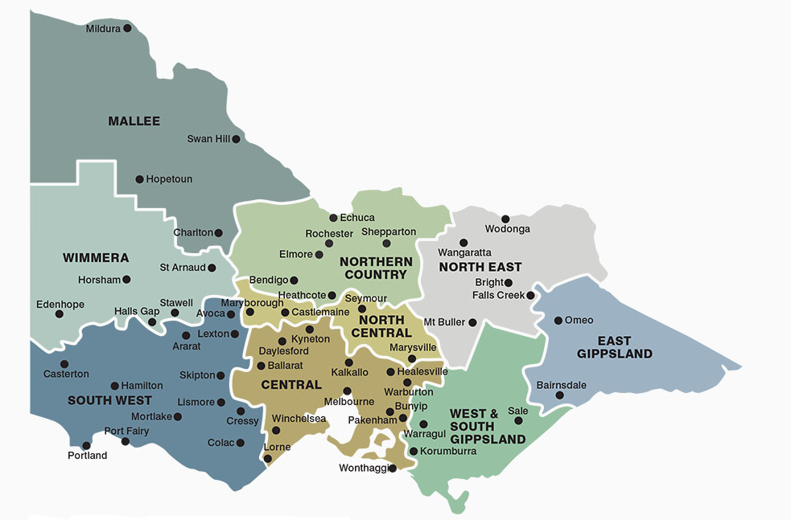
Understanding fire danger forecasts
Fire danger ratings (FDRs) provide information about the potential level of danger should a bushfire start.
FDRs are calculated by the Bureau of Meterology (BoM) for fire weather districts using a combination of weather forecasting and information about vegetation in the landscape that could fuel a fire.
Victoria has 9 fire weather districts, which are based on municipal council boundaries. Our school is in the North East fire weather district.
The BoM will publish the fire danger rating 4-day forecast on their website during the fire season, but these forecasts are subject to change.

Slide 5
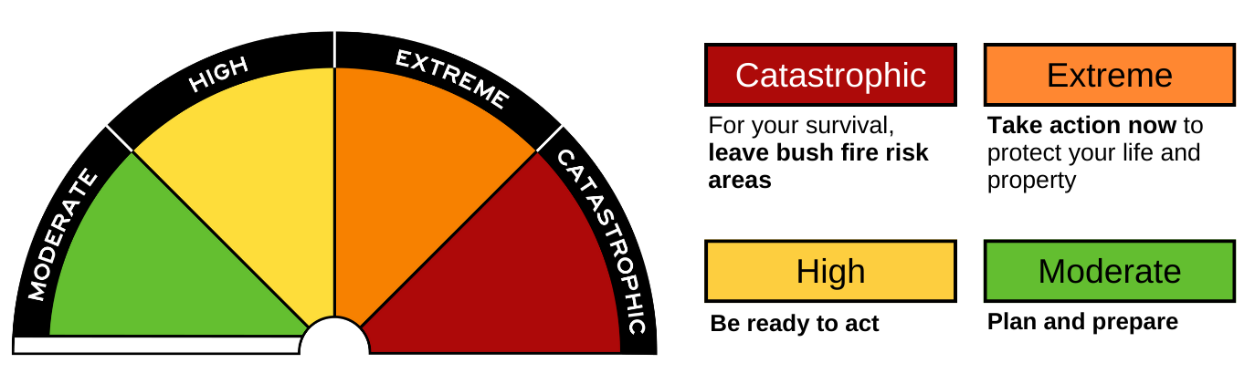
Understanding fire risk and fire danger ratings
The ratings provide information so that people can take action to protect themselves and others from the potentially dangerous impacts of bushfires.
It is important, especially during the fire season, to stay up to date with conditions, monitor your surroundings and tune in to official sources for warnings.
From the 2022-23 fire season, Victoria will be using the new Australian Fire Danger Rating System which has 4 ratings; Moderate, High, Extreme and Catastrophic.
On No Rating days, no action is required because the risk of a dangerous fire is very low.

Slide 6
The Bushfire At-Risk Register and Category 4
The Department of Education worked with the CSIRO to develop the Victorian Education Facilities Fire Risk Methodology, which is used to assess the fire risk of all early childhood and school education facilities each year.
The Bushfire At-Risk Register (BARR)
The schools and facilities in Categories 0-3 are at the highest risk of being impacted by fire in the landscape and are included on the BARR. The BARR functions as a triaged risk register to support preparation for, and response to, the annual fire season.
Category 4
Schools and facilities that are at some risk of fire pre-emptively close in response to days of Catastrophic fire risk. These sites are at the lower level of risk than those on the BARR.
Our school is a Category 4 school.

Slide 7
Our school’s fire risk and actions

Slide 8
Our fire risk and actions
Our school is a Category 4 School.
We will close on a day forecasted as a Catastrophic fire danger rating in the North East fire district.
All school bus routes that travel through a Catastrophic fire districted will be cancelled.

Slide 9
How will you be advised?
If our school needs to close on a Catastrophic fire danger day, we will advise you by sending a letter to families.
We will also communicate via our school facebook page and Xuno message.
We will try to provide you with advance notice of possible Catastrophic days when we can, please be aware that the forecast will not be confirmed until closer to the day.

Slide 10
Responding to the advice
Our families play an important role in enacting our bushfire plans.
Monitor your communications during the fire season to stay up to date. Follow the instructions provided by the school in these communications.
Be aware that for days when we will close due to Catastrophic fire danger, once the closure has been confirmed by the school, we will not change our plan, even if the forecast changes. This will help limit confusion and provide time for you to make alternative care arrangements for your children.
Find out more - information on school closure and school bus service cancellations, including advice on re-opening is available from the department's website.

Slide 11
Preparing for the fire season

Slide 12
What can you do to prepare
Make sure you understand the fire danger for our area.
Review and update your family’s bushfire survival plan, including how your child will be cared for when the school or childcare service is closed due to threat of fire. Your child should not be left unattended.
Check that we have your current contact details, including mobile phone number.
Keep in touch with us by reading our newsletters and xuno messages, checking our website, talking to your child’s teacher and to others in our school community.
Understand our Emergency Management Plan and your role in keeping the school, its students and staff safe.
Talk to your child about bushfires and your family’s bushfire survival plan.
Talk to us including our principal, teachers or school council representatives if you have any concerns.

Slide 13
Make a bushfire plan
The Country Fire Authority (CFA) provides great resources to support you and your family to plan ahead for the fire season.
Remember that you don’t have to live in the country to be at risk of fire.
As a member of our school community, we recommend thinking about how you will plan ahead for the fire season.
Taking steps to get prepared before the fire season means you know what to do when you’re at risk of fire.
Visit Your Bushfire Plan to use the CFA’s resources at: https://www.cfa.vic.gov.au/plan-prepare/before-and-during-a-fire/your-bushfire-plan

Slide 14
Frequently asked questions

Slide 15
Frequently asked questions
If I’m concerned about the risk of fires, can I keep my child away from school, even if the school remains open?
Yes. If your family decides to enact its bushfire survival plan, the most appropriate place for your child may be with you and your family, and not at school.
Talk to us about your family’s bushfire plan ahead of the fire season. You should also advise the school as soon as possible of your child’s absence if your plan is enacted.
What happens if the Catastrophic forecast improves?
The final decision to close our school due to a Catastrophic fire danger day school will be made the day prior to the planned closure.
Any improvements in the weather forecast after this time will not change the decision to close.
This will help limit confusion and provide time for parents to make alternative care arrangements for your children.

Slide 16
Frequently asked questions
When the school is closed, will any staff remain on-site?
No. The safety of staff and students is our main priority, and no staff will remain on-site, and all other visitors and contractors will also not be allowed on site.
Is it possible that schools will be closed for consecutive days?
If yes, how will parents be advised?
It is possible that our school will be closed for consecutive days. If this occurs, keep up to date via our communications.
We will be closed on all forecast Catastrophic days.
In addition to our communications, you can also check the Department’s website for updates.

Slide 17
Where to find more information

Slide 18
Further information
The Department of Education:
The department’s Bushfire and Grassfire Preparedness Policy guides our activities.
It is available online at: Bushfire and Grassfire Preparedness: Policy | education.vic.gov.au
Country Fire Authority (CFA):
Plan & Prepare | CFA (Country Fire Authority)
Your Guide to Survival | CFA (Country Fire Authority)
Fire Ready Kit | CFA (Country Fire Authority)
Other sources:
VicEmergency is a great source for information, advice and warnings. You can access it via:
The VicEmergency app – that can be downloaded on your android and iOS mobile devices
Website https://emergency.vic.gov.au
VicEmergency Hotline (1800 226 226)
Facebook (https://www.facebook.com/vicemergency)
Twitter (https://twitter.com/vicemergency)
Tune into your emergency broadcasters such as the ABC local radio, Sky News and others.

Slide 19
Thank you for attending our bushfire preparedness presentation.

Slide 20
© State of Victoria (Department of Education) 2023
Ensuring our school is bushfire ready is provided under a Creative Commons Attribution 4.0 International licence. You are free to re-use the work under that licence, on the condition that you credit the State of Victoria (Department of Education), indicate if changes were made and comply with the other licence terms, see: https://creativecommons.org/licenses/by/4.0/
The licence does not apply to: • any images, photographs, trademarks or branding, including the Victorian Government logo and the DE logo; and • content supplied by third parties.
Copyright queries may be directed to copyright@education.vic.gov.au

